Slide 1
Exception Handling
Week 10
Qurratulain Malik qmalik@keyin.com

Slide 2
Lecture Objectives
To learn how to throw exceptions
To be able to design your own exception classes
To understand the difference between checked and unchecked exceptions
To learn how to catch exceptions
To know when and where to catch an exception

Slide 3
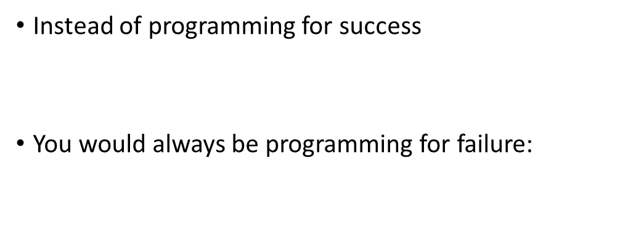
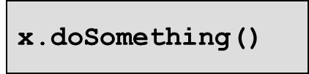
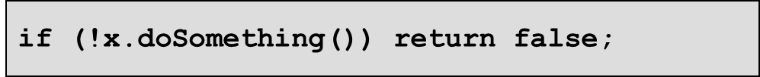
Error Handling
Traditional approach: Method returns error code
Problem: Forget to check for error code
  Failure notification may go undetected
Problem: Calling method may not be able to do anything about failure
  Program must fail too and let its caller worry about it
  Many method calls would need to be checked

Slide 4
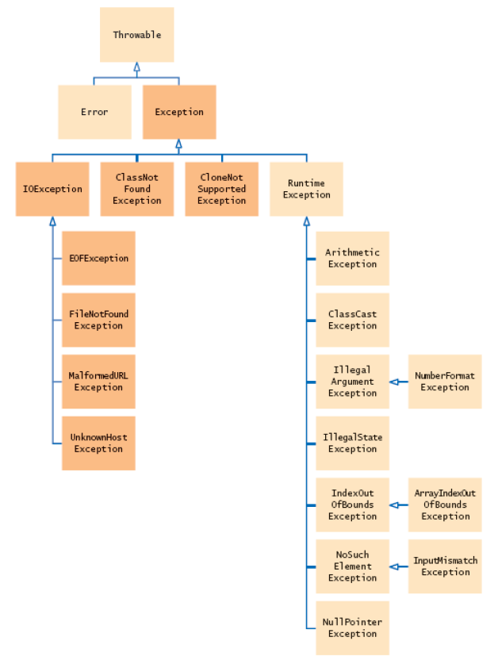
Hierarchy of Exception Classes
Figure 1: The Hierarchy of Exception Classes

Slide 5
Exceptions
An exception is an object that describes an unusual or erroneous situation
Exceptions are thrown by a program, and may be caught and handled by another part of the program
A program can be separated into a normal execution flow and an exception execution flow
An error is also represented as an object in Java, but usually represents a unrecoverable situation and should not be caught

Slide 6
Exception Handling
Java has a predefined set of exceptions and errors that can occur during execution
A program can deal with an exception in one of three ways:
  ignore it
  handle it where it occurs
  handle it an another place in the program
The manner in which an exception is processed is an important design consideration

Slide 7
Exception Handling
If an exception is ignored by the program, the program will terminate abnormally and produce an appropriate message
The message includes a call stack trace that indicates the line on which the exception occurred
The call stack trace also shows the method call trail that lead to the attempted execution of the offending line
  The getMessage method returns a string explaining why the exception was thrown
  The printStackTrace method prints the call stack trace

Slide 8
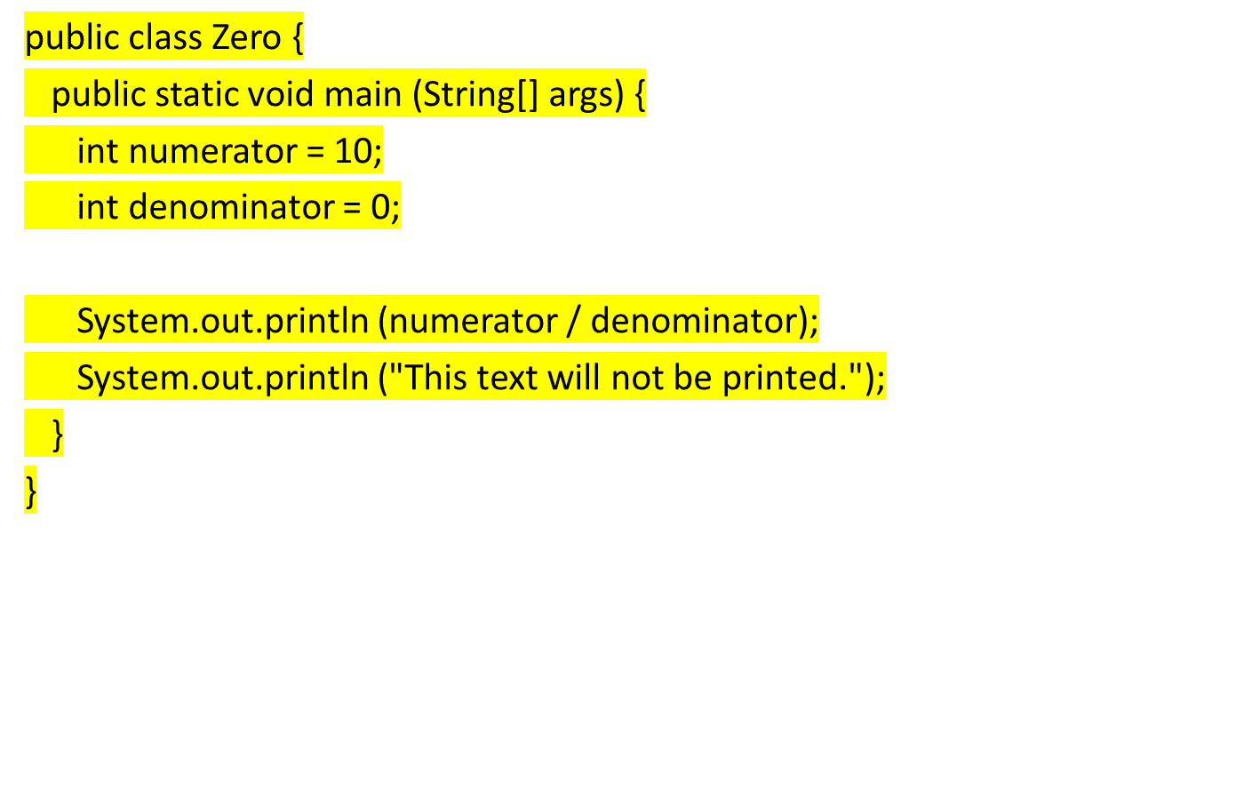
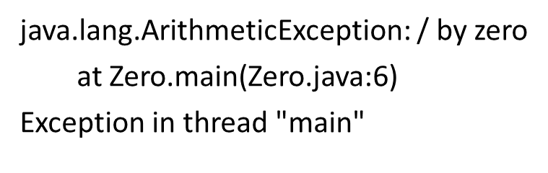
Zero

Slide 9
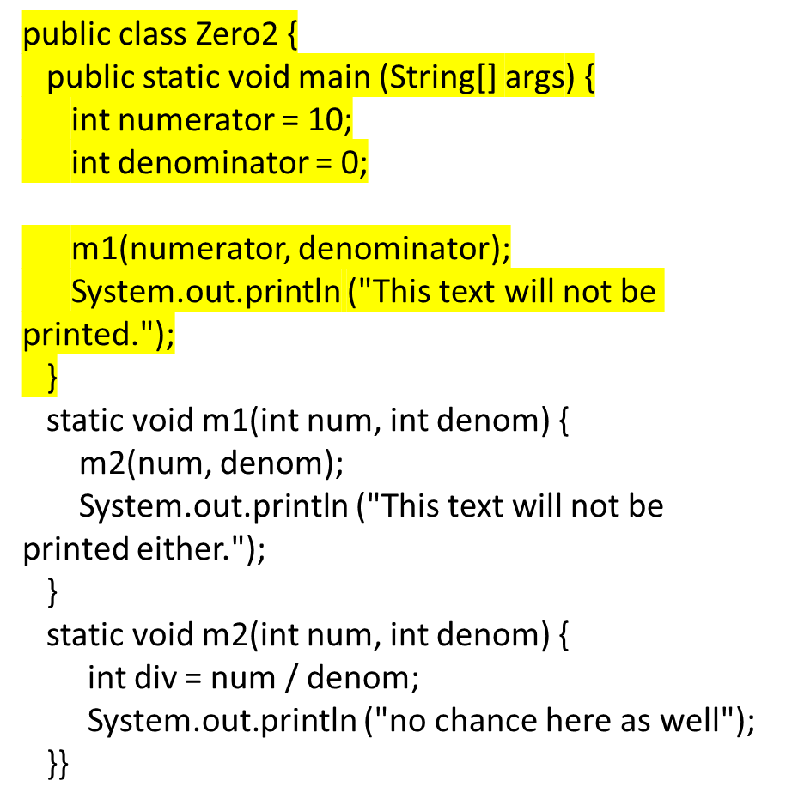
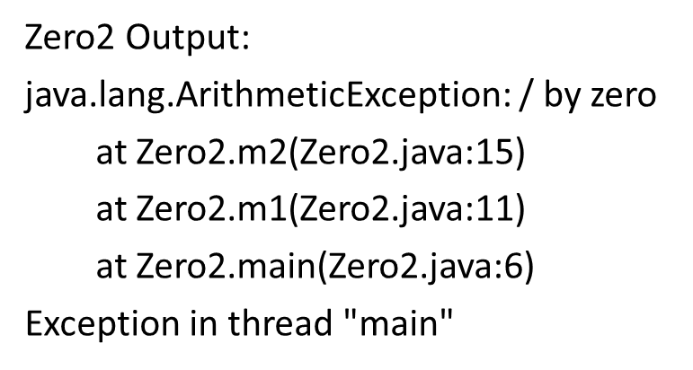
Zero2

Slide 10
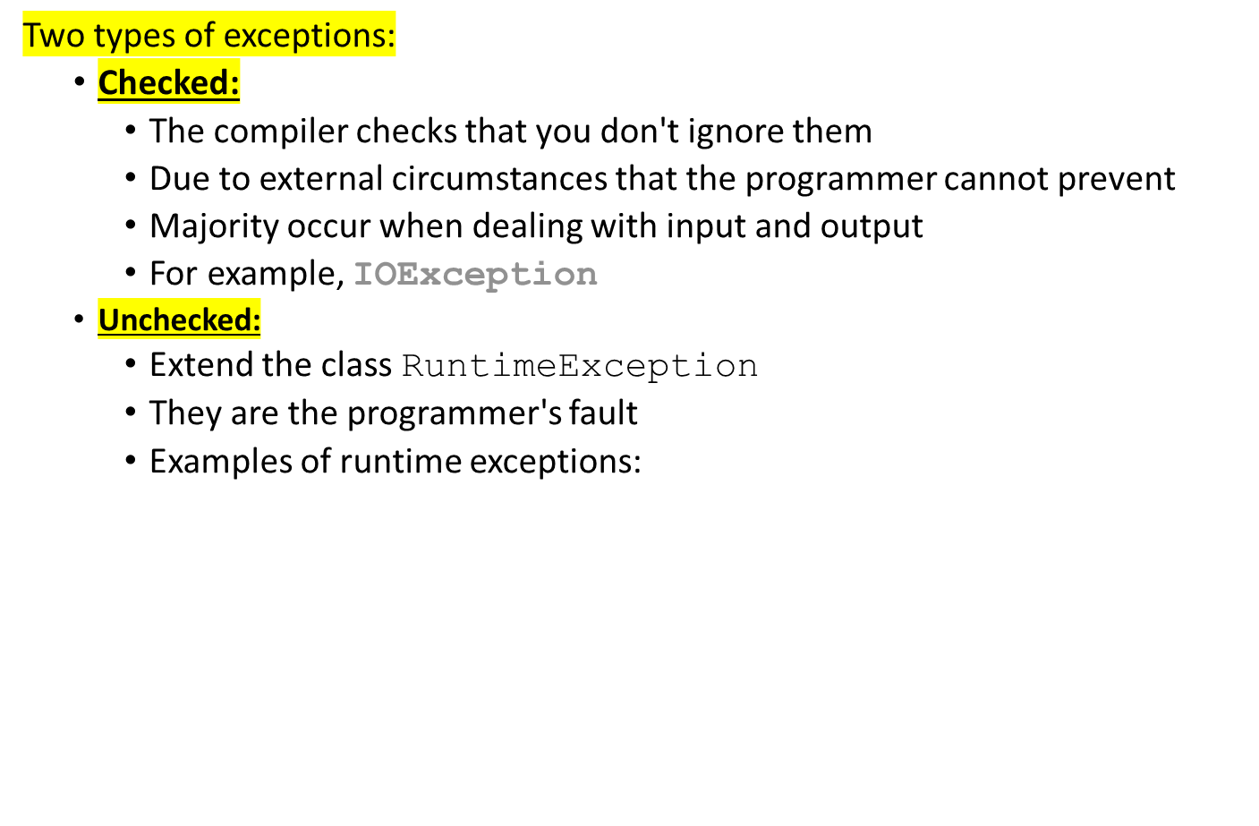
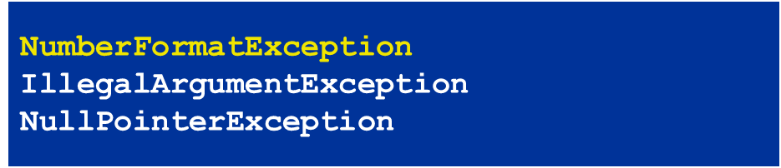
Checked and Unchecked Exceptions

Slide 11
Checked and Unchecked Exceptions (Cont’d)
Categories aren't perfect:
  Scanner.nextInt throws unchecked InputMismatchException
  Programmer cannot prevent users from entering incorrect input
  This choice makes the class easy to use for beginning programmers
Deal with checked exceptions principally when programming with files and streams

Slide 12
Checked and Unchecked Exceptions (Cont’d)
Two choices:
  Handle the exception
  Tell compiler that you want method to be terminated when the exception occurs
    Use throws specifier so method can throw a checked exception
public void read(String filename) throws FileNotFoundException
{
FileReader reader = new FileReader(filename);
Scanner in = new Scanner(reader);
. . .
}

Slide 13
Checked and Unchecked Exceptions (Cont’d)
  For multiple exceptions:
  Keep in mind inheritance hierarchy:
  If method can throw an IOException and FileNotFoundException, only use IOException
Better to declare exception than to handle it incompetently
public void read(String filename)
throws IOException, ClassNotFoundException

Slide 14
Checked Exceptions
An exception is either checked or unchecked
A checked exception either must be caught by a method, or must be listed in the throws clause of any method that may throw or propagate it
A throws clause is appended to the method header
The compiler will issue an error if a checked exception is not handled appropriately

Slide 15
Unchecked Exceptions
An unchecked exception does not require explicit handling, though it could be processed that way
The only unchecked exceptions in Java are objects of type RuntimeException or any of its descendants
Errors are similar to RuntimeException and its descendants
  Errors should not be caught
  Errors to not require a throws clause

Slide 16
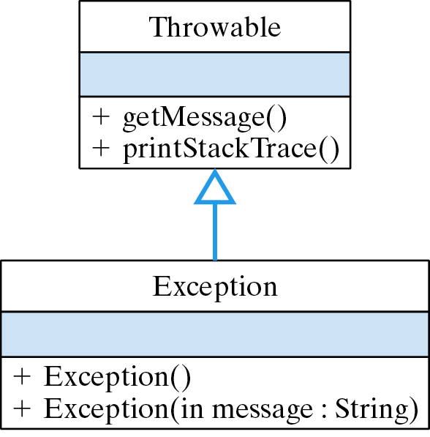
The Exception Class
Simple: only constructor methods.

Slide 17
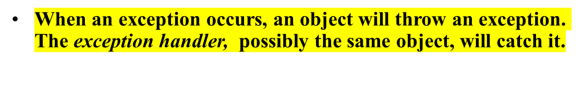
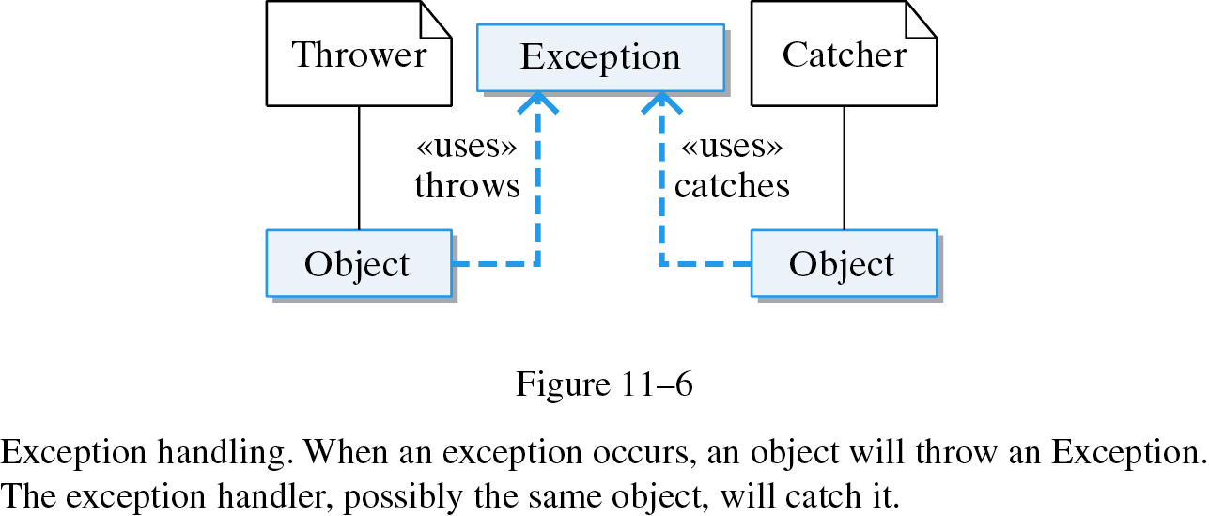
Handling Exceptions
Figure 6: Flow of Handling Exceptions

Slide 18
Catching Exceptions
try block contains statements that may
cause an exception
catch clause contains handler for an
exception type

Slide 19
The try Statement
To process an exception when it occurs, the line that throws the exception is executed within a try block
A try block is followed by one or more catch clauses, which contain code to process an exception
Each catch clause has an associated exception type and is called an exception handler
When an exception occurs, processing continues at the first catch clause that matches the exception type

Slide 20
Catching Exceptions (Cont’d)
Example:
try {
String filename = . . .;
FileReader reader = new FileReader(filename);
Scanner in = new Scanner(reader);
String input = in.next();
int value = Integer.parseInt(input);
. . .
}
catch (IOException exception) {
exception.printStackTrace();
}
catch (NumberFormatException exception) {
System.out.println("Input was not a number");
}

Slide 21
Catching Exceptions (Cont’d)
Statements in try block are executed
If no exceptions occur, catch clauses are skipped
If exception of matching type occurs, execution jumps to catch clause
If exception of another type occurs, it is thrown until it is caught by another try block
Continued…

Slide 22
Catching Exceptions (Cont’d)
catch (IOException exception) block
  exception contains reference to the exception object that was thrown
  catch clause can analyze object to find out more details
  exception.printStackTrace(): printout of chain of method calls that lead to exception

Slide 23
Syntax: General Try Block
try {
statement
statement
. . .
}
catch (ExceptionClass exceptionObject) {
statement
statement
. . .
}
catch (ExceptionClass exceptionObject) {
statement
statement
. . .
}
. . .

Slide 24
Syntax: General Try Block (Cont’d)
Example:
try {
System.out.println("How old are you?");
int age = in.nextInt();
System.out.println("Next year, you'll be " + (age + 1));
}
catch (InputMismatchException exception) {
exception.printStackTrace();
}
Purpose:
To execute one or more statements that may generate exceptions. If an exception
occurs and it matches one of the catch clauses, execute the first one that matches.
If no exception occurs, or an exception is thrown that doesn't match any catch
clause, then skip the catch clauses.

Slide 25
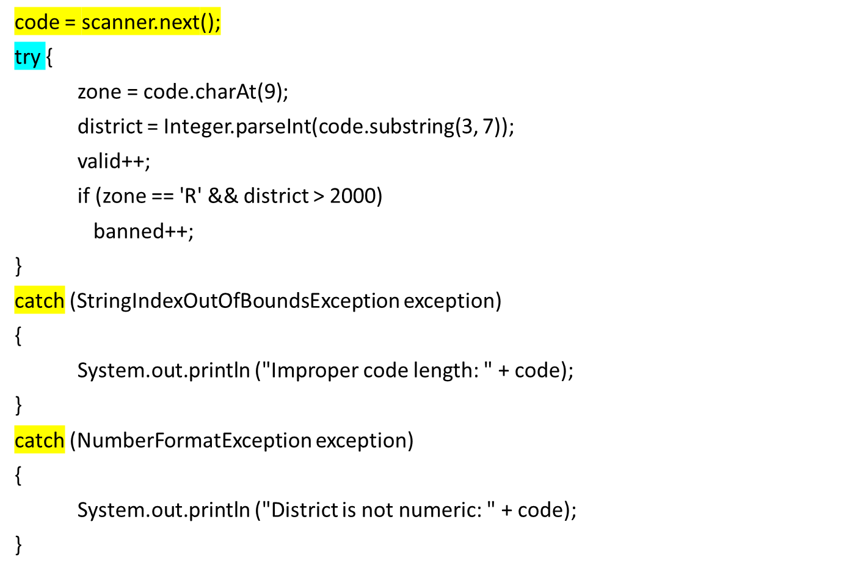
ProductCodes

Slide 26
The finally Clause
A try statement can have an optional clause following the catch clauses, designated by the reserved word finally
The statements in the finally clause always are executed
If no exception is generated, the statements in the finally clause are executed after the statements in the try block complete
If an exception is generated, the statements in the finally clause are executed after the statements in the appropriate catch clause complete

Slide 27
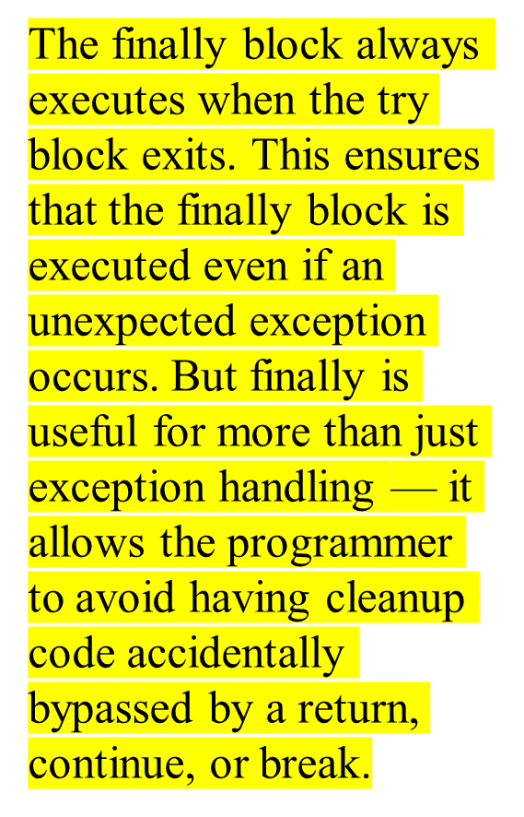
Finally Example
int numerator = 10;
int denominator = 0;
try {
System.out.println (numerator / denominator);
System.out.println ("This text will not be printed.");
}
catch(java.lang.ArithmeticException e) {
System.out.println ("This text will be printed.");
}
finally {
System.out.println ("This text will also be printed.");
}

Slide 28
Throwing Exceptions
Exceptions:
  Can't be overlooked
  Sent directly to an exception handler–not just caller of failed method
Throw an exception object to signal an exceptional condition
Example: IllegalArgumentException:
illegal parameter value
IllegalArgumentException exception
= new IllegalArgumentException("Amount exceeds balance");
throw exception;
Continued…

Slide 29
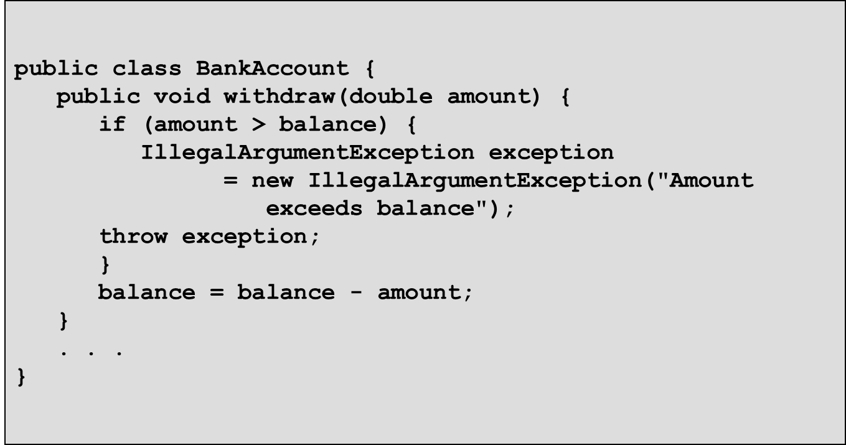
Throwing Exceptions (Cont’d)
No need to store exception object in a variable:
When an exception is thrown, method terminates immediately
  Execution continues with an exception handler
throw new IllegalArgumentException("Amount exceeds balance");

Slide 30
Syntax: Throwing an Exception
throw exceptionObject;
Example:
throw new IllegalArgumentException();
Purpose:
To throw an exception and transfer control to a handler for this
exception type

Slide 31
MyException
public class MyException extends Exception
{
//-----------------------------------------------------------------
// Sets up the exception object with a particular message.
//-----------------------------------------------------------------
MyException(String message)
{
super (message);
}
}

Slide 32
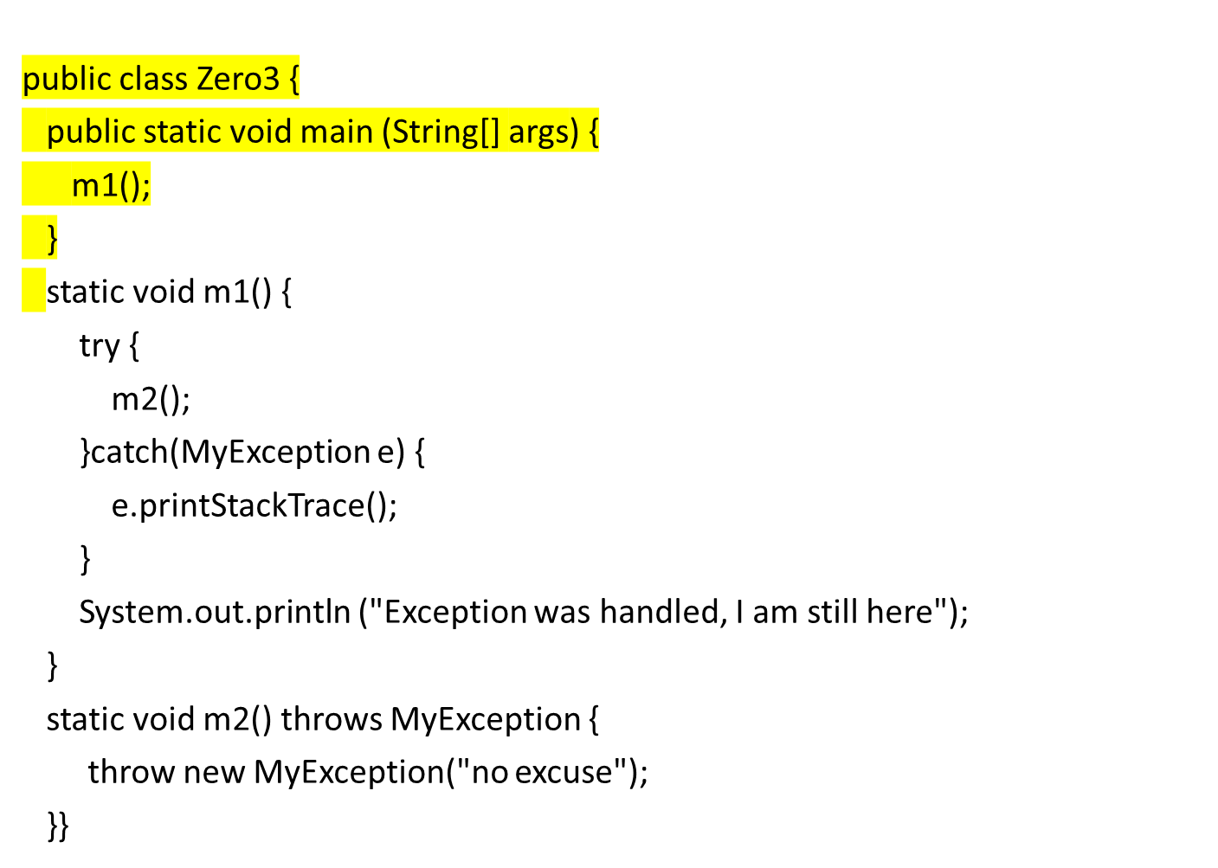

Slide 33
Output
MyException: no excuse
at Zero3.m2(Zero3.java:15)
at Zero3.m1(Zero3.java:8)
at Zero3.main(Zero3.java:3)
Exception was handled, I am still here

Slide 34
The throw Statement (Summary)
A programmer can define an exception by extending the Exception class or one of its descendants
Exceptions are thrown using the throw statement
Usually, a throw statement is nested inside an if statement that evaluates the condition to see if the exception should be thrown

Slide 35
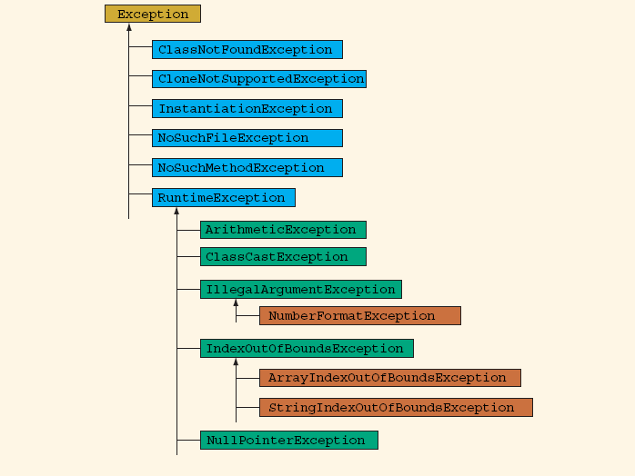
Hierarchy of Exception Classes (Cont’d)
Figure 2: The Hierarchy of Exception Classes

Slide 36
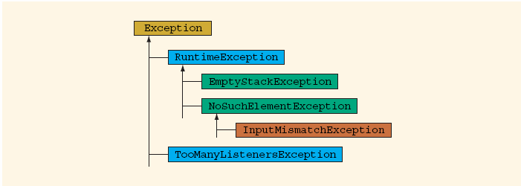
Hierarchy of Exception Classes (Cont’d)
Figure 3: The Hierarchy of Exception Classes

Slide 37
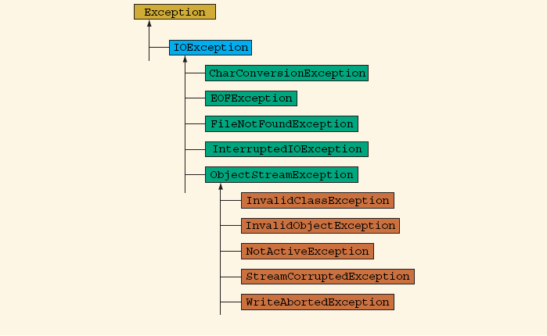
Hierarchy of Exception Classes (Cont’d)
Figure 4: The Hierarchy of Exception Classes

